Slide 1

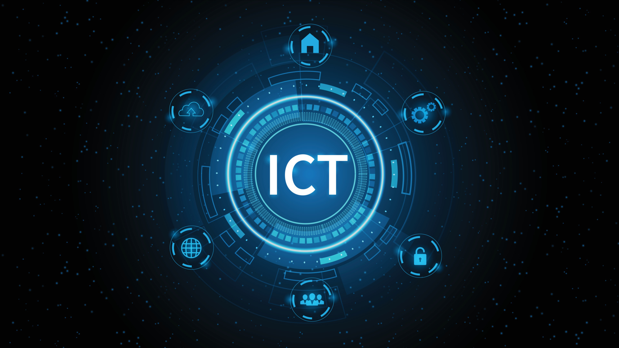
Timeline
Ict
Education
In Bhutan
Eshfisehhgksdbvk,dfjbkdfb ,fhvhilsuhvdjvhszughsou

Slide 2
Timeline
of
Computer

Slide 3

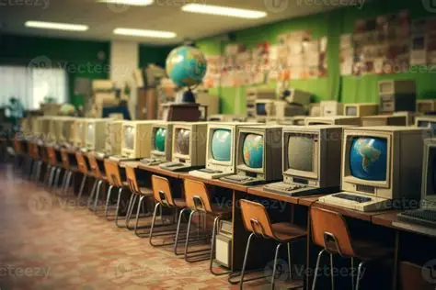
1992
Late 1980s
Ict as optional
subject
First computers
in Bhutanese schools
Some secondary schools began offering ICT as an elective subject for interested students.
Gateway computers donated under the Overseas Development Administration introduced basic computer literacy in select schools.

Slide 4
1992
Late 1980s
Ict as optional
subject
First computers
in Bhutanese schools
Some secondary schools began offering ICT as an elective subject for interested students.
Gateway computers donated under the Overseas Development Administration introduced basic computer literacy in select schools.

Slide 5


1992
2002
ICT curriculum
introduced
First computers
in Bhutanese schools
Focus shifted from programming basics to practical applications like word processing, spreadsheets, and presentations.
Gateway computers donated under the Overseas Development Administration introduced basic computer literacy in select schools.

Slide 6
2010
2011 - 2013
Chiphen Rigphel Project launched
WIRED & OLPC initiatives
A Bhutan–India initiative to train teachers, establish computer labs in 168 schools, and make ICT mandatory from Class VII.
WIRED integrated ICT in teaching; OLPC provided laptops to students in rural schools.

Slide 7
2010
2011 - 2013
WIRED & OLPC initiatives
Chiphen Rigphel Project launched
WIRED integrated ICT in teaching; OLPC provided laptops to students in rural schools.
A Bhutan–India initiative to train teachers, establish computer labs in 168 schools, and make ICT mandatory from Class VII.

Slide 8
2011 - 2013
2013
2018 - 2019
iSherig – Education ICT Master Plan
WIRED & OLPC initiatives
Ministry of Education finalised iSherig to expand ICT access, curriculum, and teacher capacity nationwide.
WIRED integrated ICT in teaching; OLPC provided laptops to students in rural schools.

Slide 9
2011 - 2013
2013
WIRED & OLPC initiatives
iSherig – Education ICT Master Plan
WIRED integrated ICT in teaching; OLPC provided laptops to students in rural schools.
Ministry of Education finalised iSherig to expand ICT access, curriculum, and teacher capacity nationwide.

Slide 10
2017
2013
ICT curriculum
expanded to primary
iSherig – Education ICT Master Plan
Introduced for Classes IV–VI, building ICT skills from an earlier age.
Ministry of Education finalised iSherig to expand ICT access, curriculum, and teacher capacity nationwide.

Slide 11
2018 - 2019
2017
ICT compulsory from
Class IX
ICT curriculum
expanded to primary
Two ICT classes per week for Classes IV–X; office applications phased out from higher grades.
Introduced for Classes IV–VI, building ICT skills from an earlier age.

Slide 12
2021
2018 - 2019
ICT from PP to Class XII
ICT compulsory from
Class IX
ICT designated as a “third language” alongside Dzongkha and English; part of Education Flagship Programme.
Two ICT classes per week for Classes IV–X; office applications phased out from higher grades.

Slide 13
Timeline
of
Computer
Thank you

